Slide 1
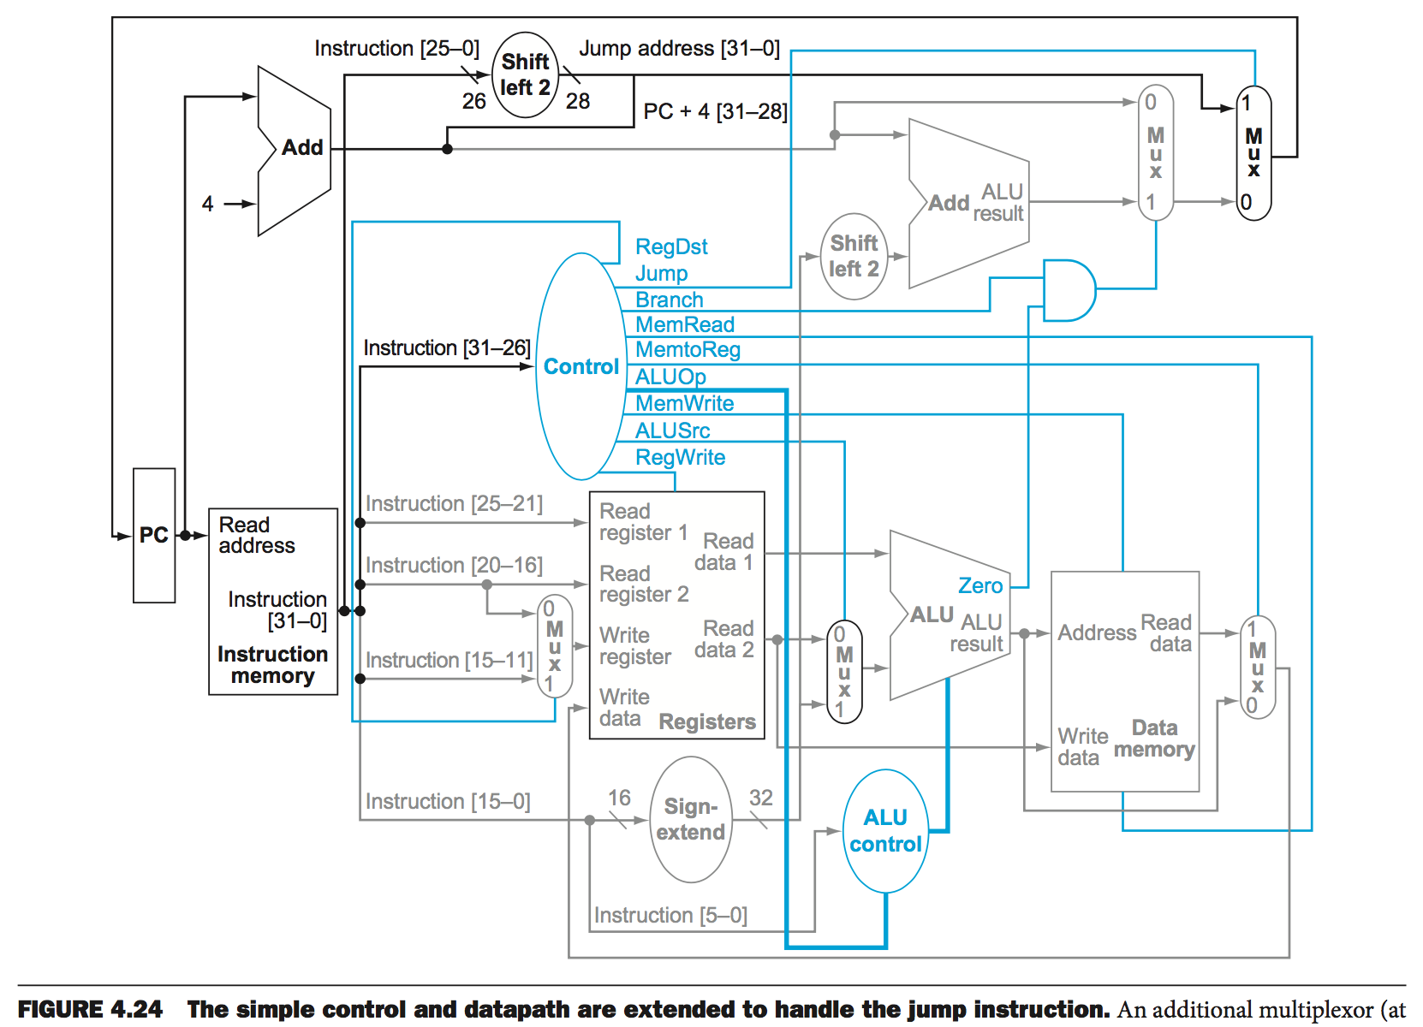
INS25-0, JTImm
PCnext
PC+4
1
2
BTaddr
PC+4OrBTaddr
INS31-26, Func
PCnext
PC
INS25-21, RSselect
RSvalue, ALUin1
INS20-16, RTselect
3
ALUout
MEMout
5
ALUin2
INS15-11, RDselect
4
RWselect
RTvalue, MEMin
INS15-0, Imm
ALUout
ignore
ignore
RWvalue

Slide 2
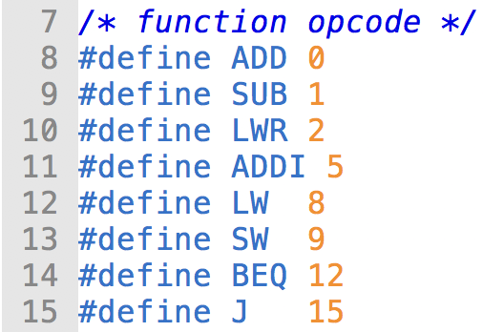
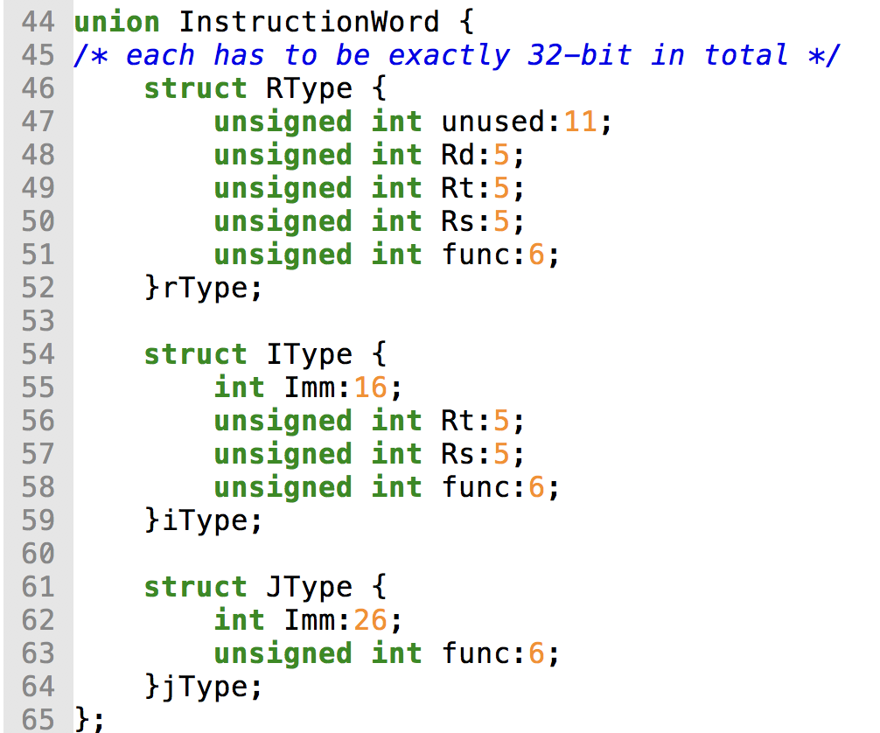
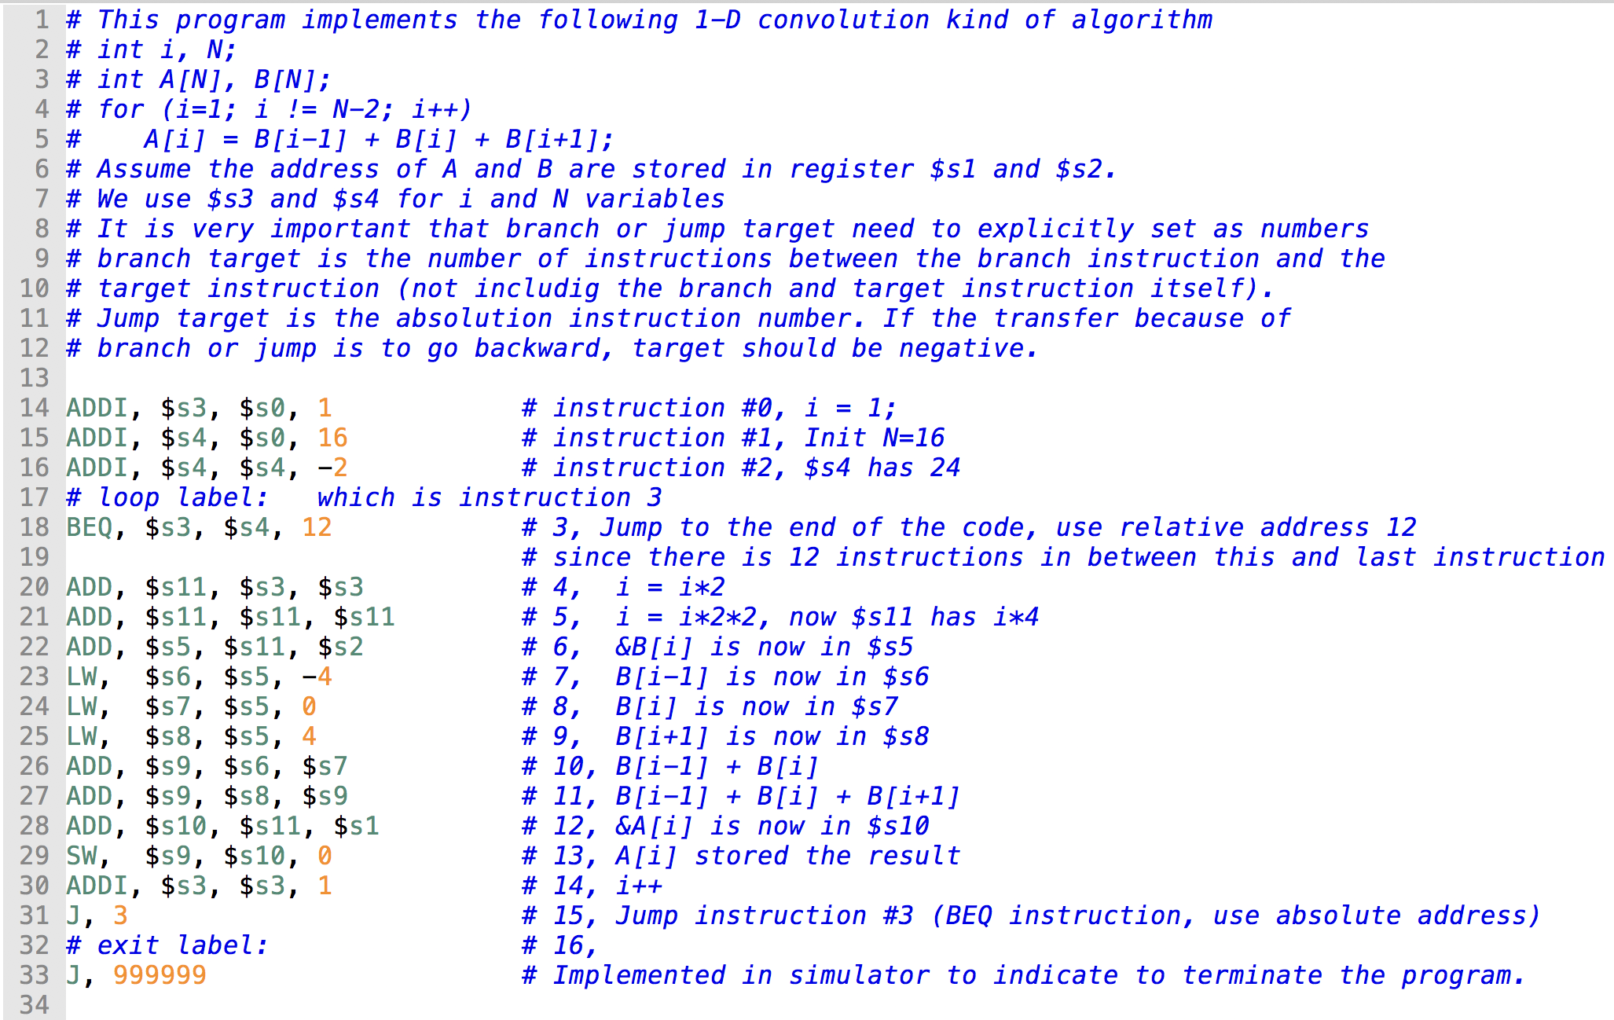
cpusim.c and test.asm

Slide 3
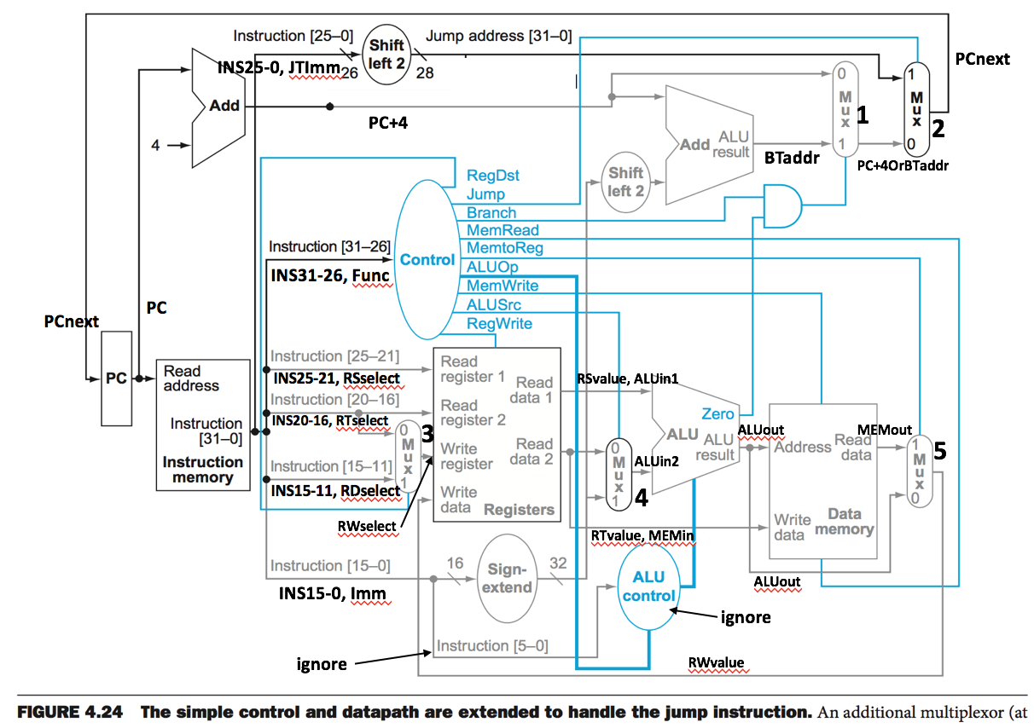
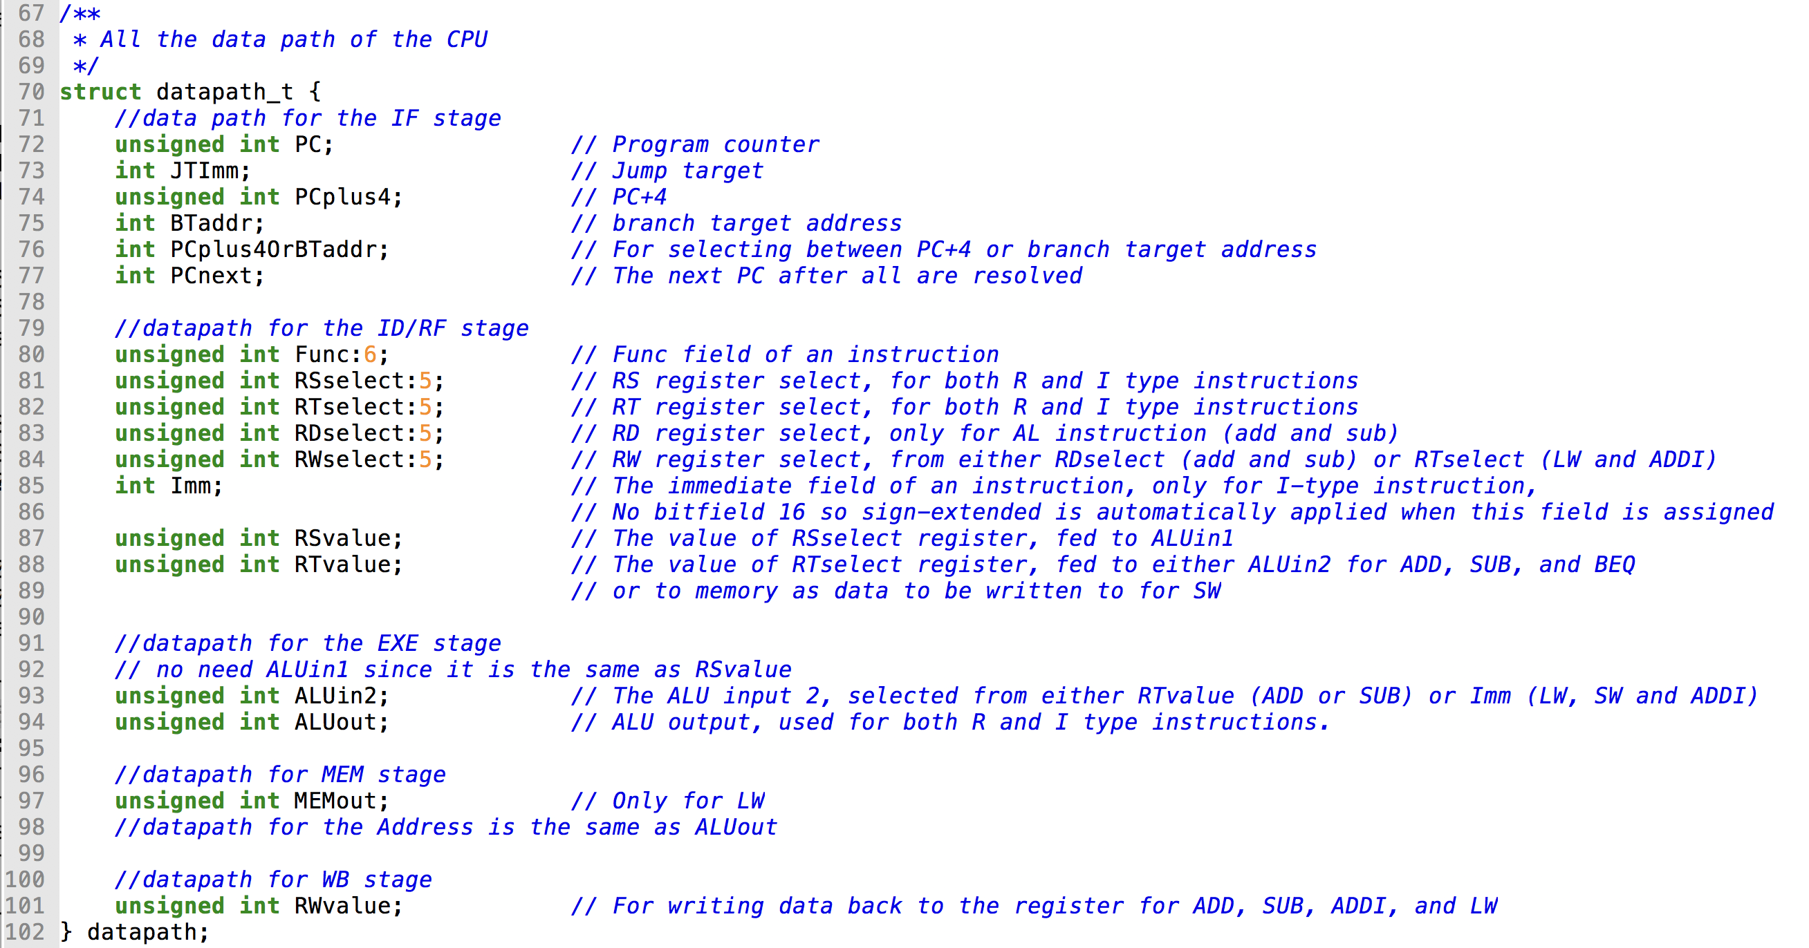
Datapath in cpusim.c

Slide 4
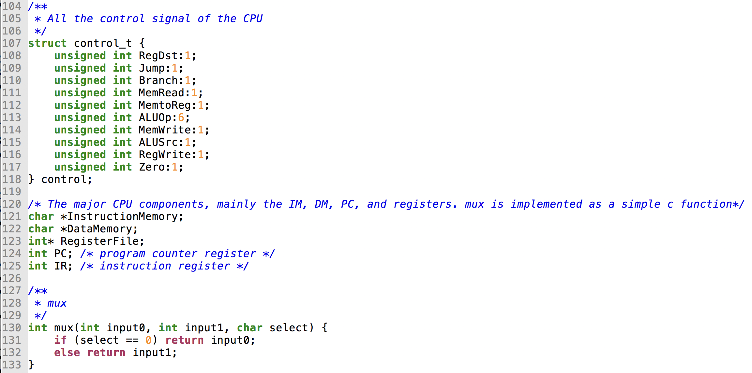
control and others in cpusim.c

Slide 5
Check more details in the cpusim.c

